Slide 1
Using Measures of Genetic Diversity as Estimates for Conservation Status in Animal Phyla
Anais Aoki
Biol 606 Final Presentation

Slide 2
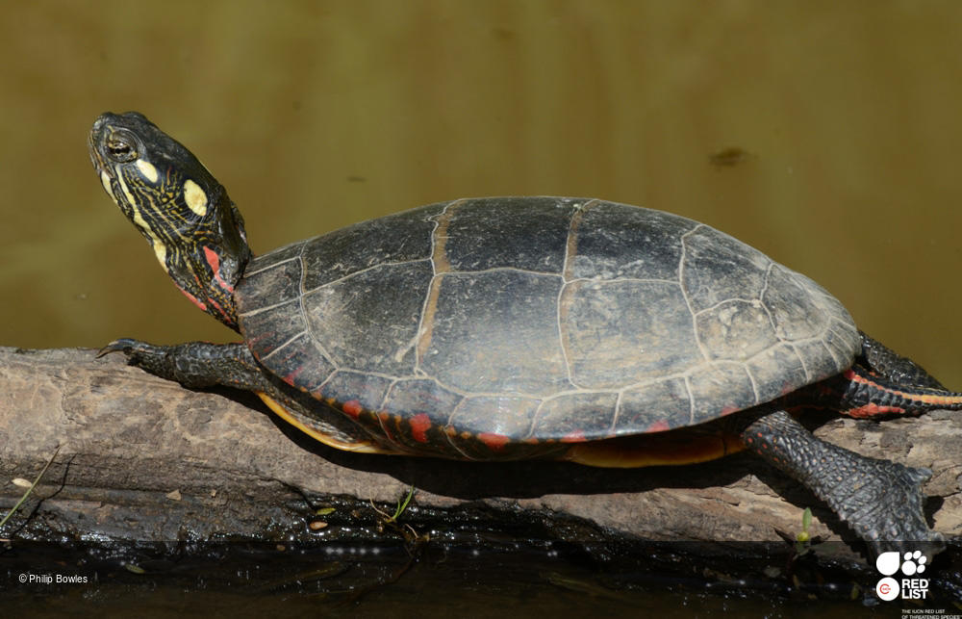
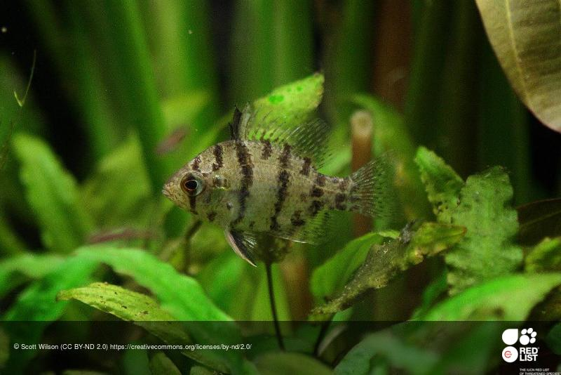
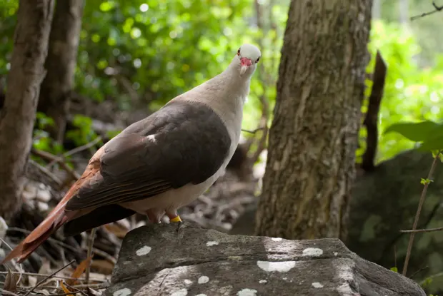
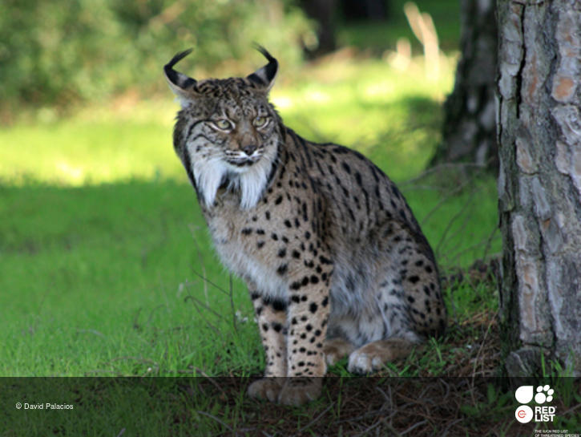
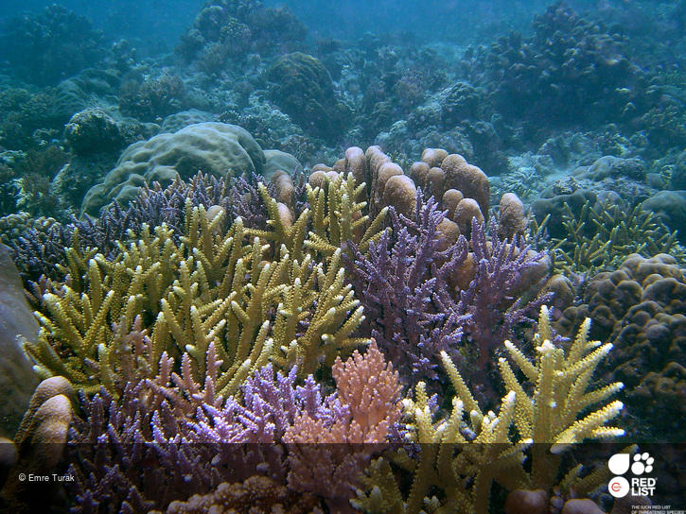
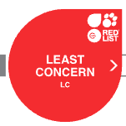
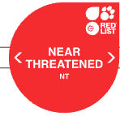
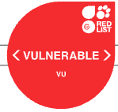
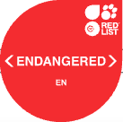
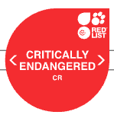
International Union of Conservation of Nature (IUCN)
Global organization uses a set of criteria to maintain a ranking of species based on their conservation status, known as their RedList
IUCN estimates census size on based on criteria such as population decline and number of mature adults
Currently does not utilize measures of genetic diversity to rank species
Notes:
This is widely recognized and used as an indicator to determine extinction risk
Guides scientific research,commonly reported in scientific research, inform policy makers, influences resource allocation, brings awareness

Slide 3
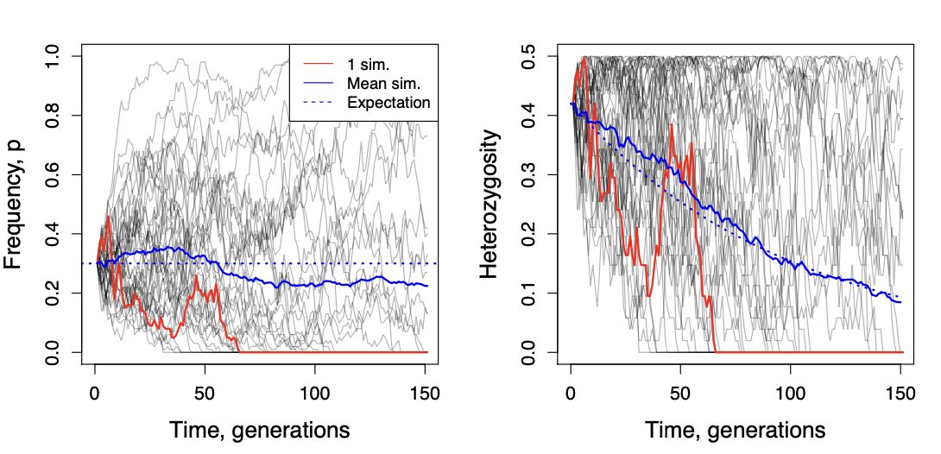
Genetic Diversity
Allele: Alternative form of a gene
Heterozygote: An organism that has different alleles at a locus
Heterozygosity: proportion of heterozygotes within a population (genetic diversity)
Mean number of alleles: gene diversity
Allelic richness: gene diversity but accounts for different population sizes
Simulated of change in frequency of ‘p’ allele (left) and resulting change in heterozygosity (right) over 150 generations
Notes:
Heterozygosity: general measure for genetic variation within a population
Endangered populations have typically gone through a process of decline and fragmentation during which genetic drift is expected to have a strong effect over selection and gene flow.
As a result, genetic diversity might be lost, slightly deleterious alleles might increase in frequency or even become fixed and homozygosity might increase as a consequence of diversity loss
The occurrence of these circumstances might in turn compromise the viability of the populations, as they are expected to result in reduced adaptive potential and lower individual fitness due to the increased opportunities for matings among relatives (inbreeding).
Fst: (greater fst, greater genetic divergence)

Slide 4
Meta-Analysis of Conservation Genetics Literature
Are estimates of heterozygosity and allele diversity, currently not utilized by the IUCN to rank threatened species, good predictors of endangerment?
It is hypothesized that as species become endangered they experience a reduction in genetic and allelic diversity
Notes:
Th

Slide 5
Literature Sampling & Data Collection
Collated data from published articles that focused on conservation and population genetics from the repository DataDryad
Studies that were used were published from the years 2010-2022
There are 342 species included in this meta-analysis and range across animal phyla
which include marine and land mammals, birds, fish, amphibians, reptiles and insects
Species in each class were categorized by their IUCN RedList ranking as well as their threat level (Least concern, near threatened, vulnerable, endangered and critically endangered)
IUCN RedList ranking and threat level (non-threatened vs threatened) are the response variables
The independent variables are observed and expected heterozygosity, allelic richness, and mean number of alleles

Slide 6
Methods
Imputed missing data using the randomForest package in R
Check for correlation between genetic diversity measures and IUCN ranking for both raw data and imputed data
Ran NMDS ordination on imputed dataset using the Vegan package, using Eucledian as the distance metric
Visualized the dissimilarities between species IUCN RedList ranking and species threat level by plotting the distance matrix of the NMDS analysis
Ran NMDS ordination on subsetted class Mammalia data and visualized distance matrix grouping data by threat level and IUCN status

Slide 7
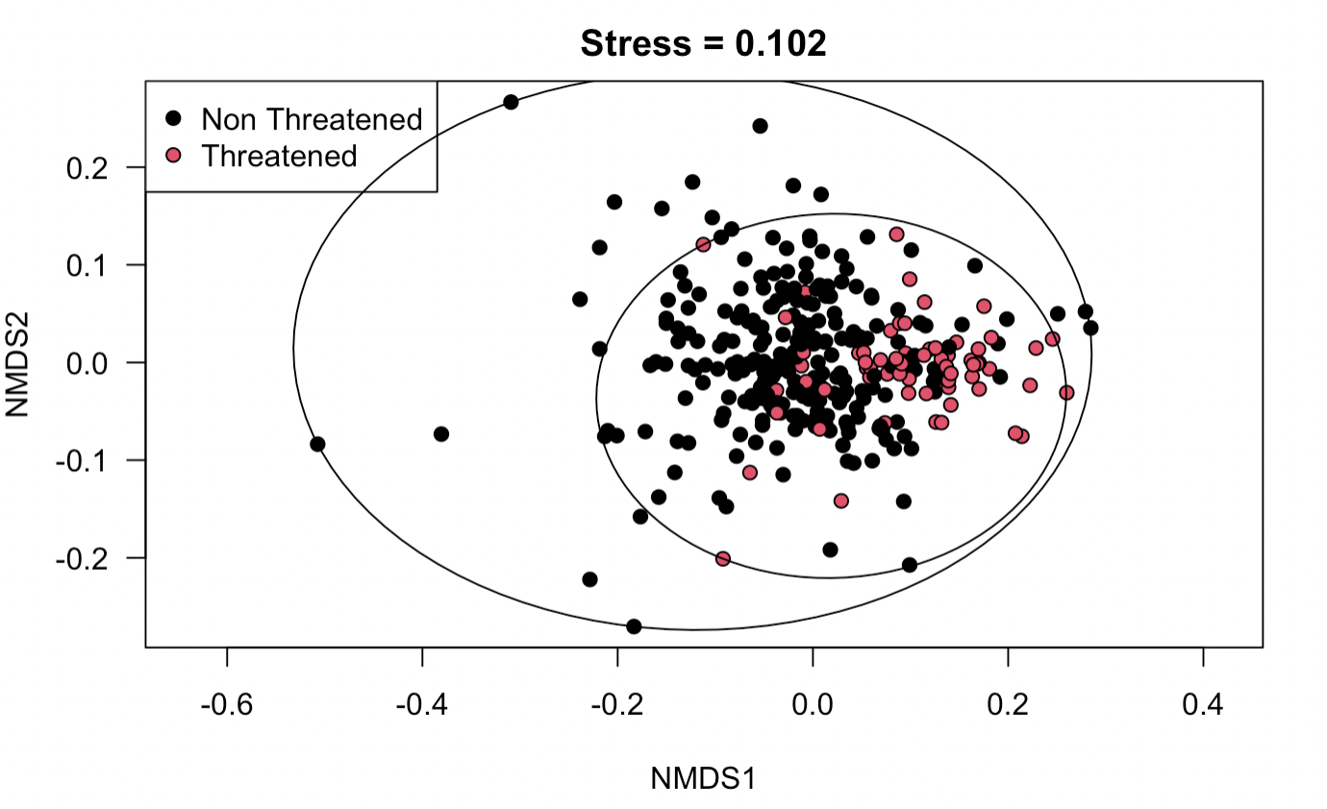
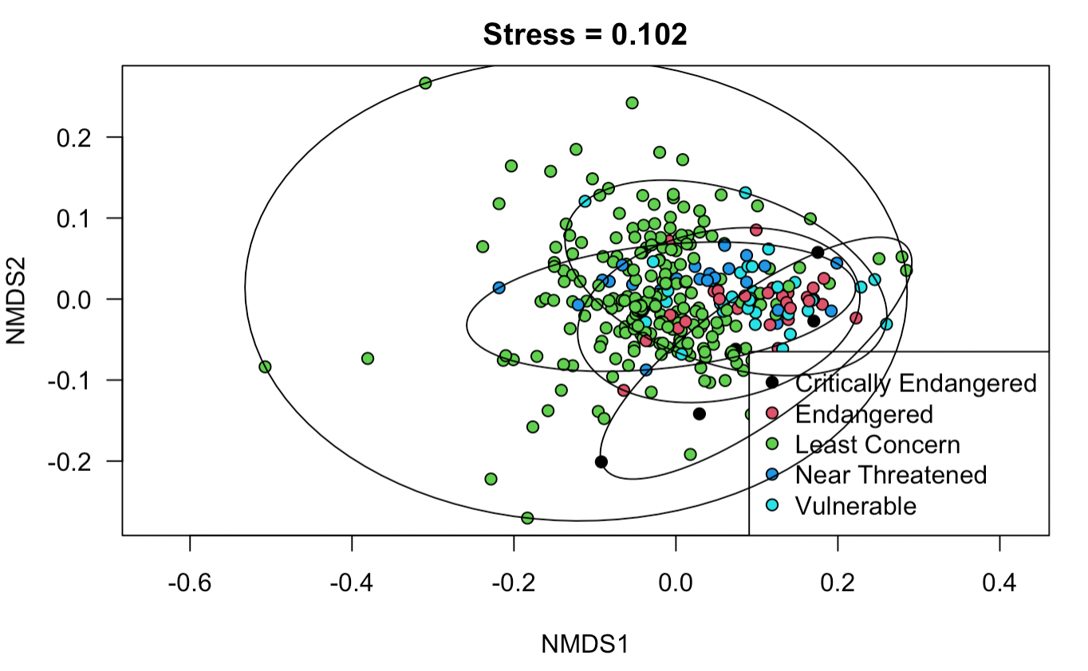
NMDS analysis across all classes
Distance matrix of species genetic diversity measures grouped by threat level
Distance matrix of species genetic diversity measures grouped by IUCN status

Slide 8
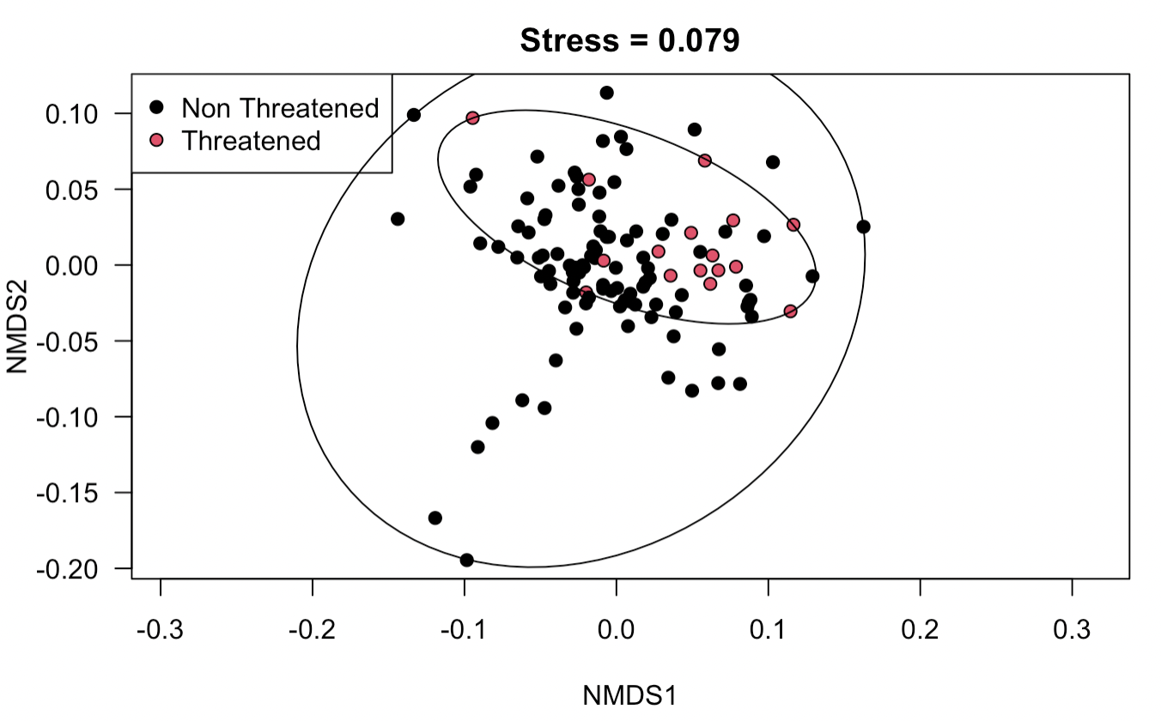
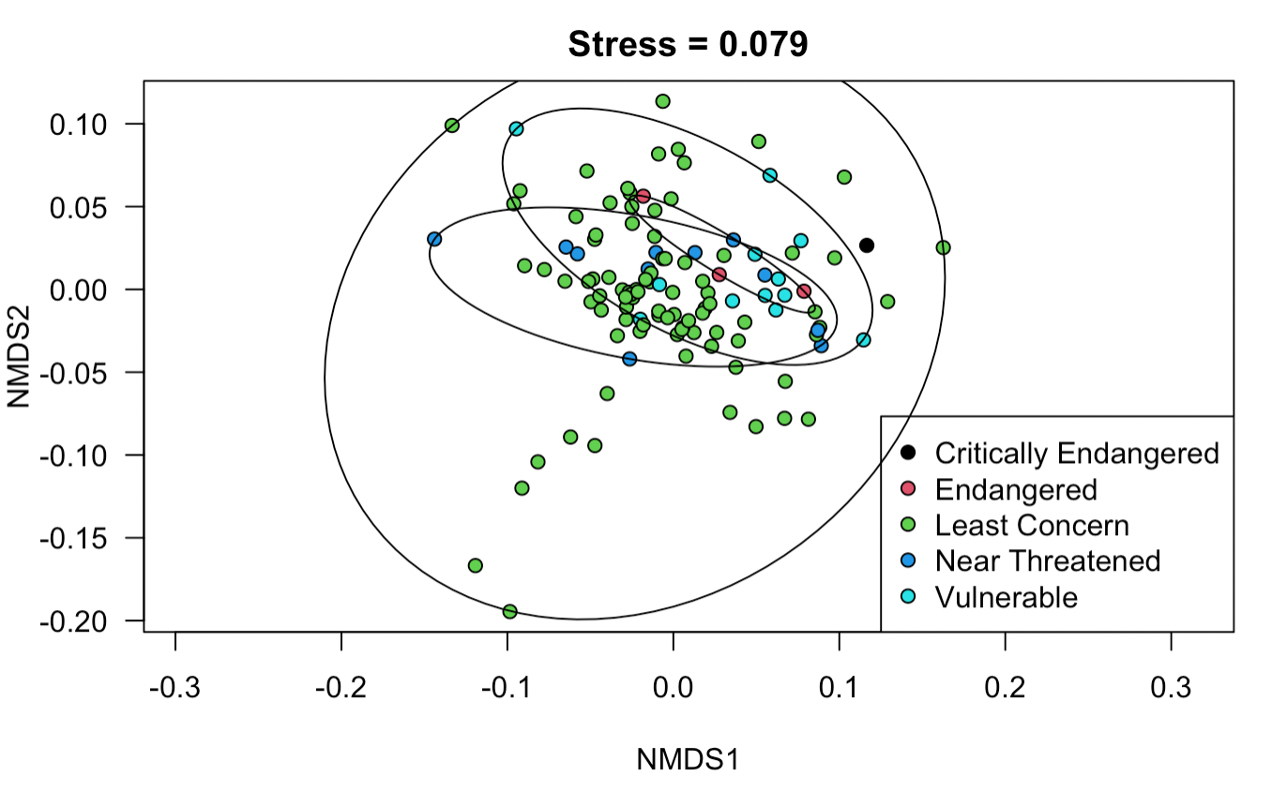
NMDS analysis of class Mammalia
Distance matrix of mammal’s genetic diversity measures grouped by threat level
Distance matrix of mammal’s genetic diversity measures grouped by IUCN RedList ranking

Slide 9
Discussion
Overall, when looking at genetic diversity measures across species according to their IUCN status they are clustered very close to one another
By grouping them threat level the data has better cluster separation
Low separation can also be attributed to grouping taxa together. There may be significant differences between taxonomic groups genetic diversity measures
When looking at class Mammalia, genetic diversity measures better accounts for species threat level compared to IUCN status
To improve overall inference of genetic diversity measures on IUCN status
Increase overall sample size (imbalanced data)
Increase overall sampling of species classified as threatened (more endangered)

Slide 10
Citations
Liaw A, Wiener M (2002). “Classification and Regression by randomForest.” R News, 2(3), 18-22. https://CRAN.R-project.org/doc/Rnews/.
Oksanen, J., Blanchet, F.G., Friendly, M., et al. (2021). vegan: Community Ecology Package. R package version 2.5-7. https://CRAN.R-project.org/package=vegan R Development Core Team. 2018. R: A Language and Environment for Statistical Computing. R Foundation for Statistical Computing, Vienna, Austria.

